Slide 1
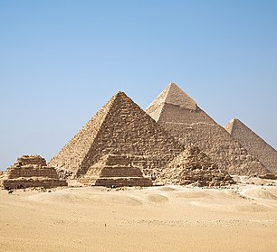
Ancient Egypt

Slide 2
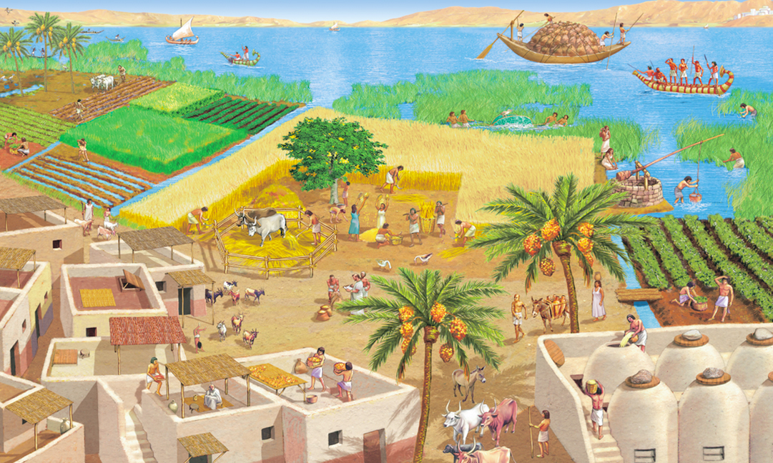
BASIC INFORMATIONs
The ancient EGYPT civilisation was situated in the Nile Valley
It has a lot of transitions in years since it is almost the very first great civilization, but they are dated around 3150-332BC

Slide 3
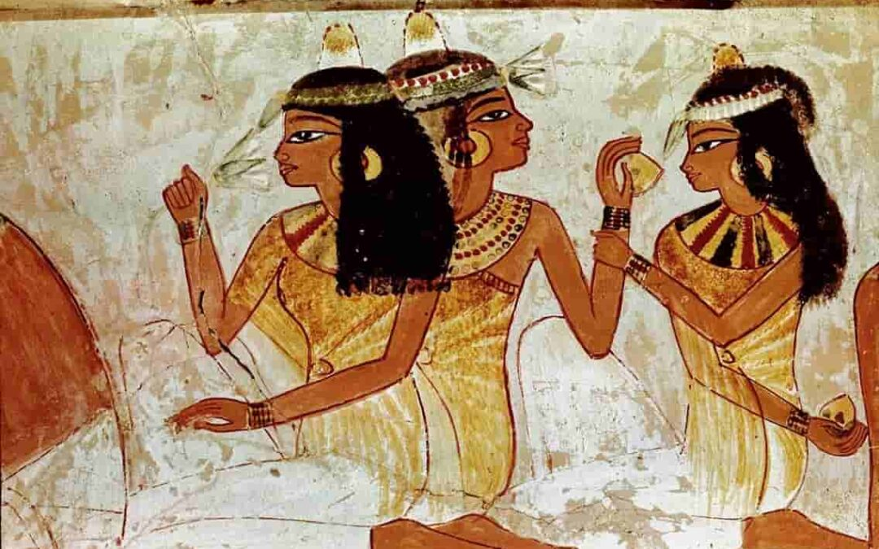
APPEARANCE
Wealthy men wore knee-length shirts, loincloths or kilts and adorned themselves with jewellery – a string of beads, armlets and bracelets
Working-class women wore full-length wraparound gowns and close-fitting sheaths
Elite women enhanced their appearance with make-up, earrings, bracelets and necklaces
The ancient Egyptians were very particular about cleanliness and personal appearance
People who were poorly groomed were considered inferior
Both men and women used cosmetics and wore jewellery
One item of jewellery, the amulet, was believed to protect the owners and give them strength

Slide 4
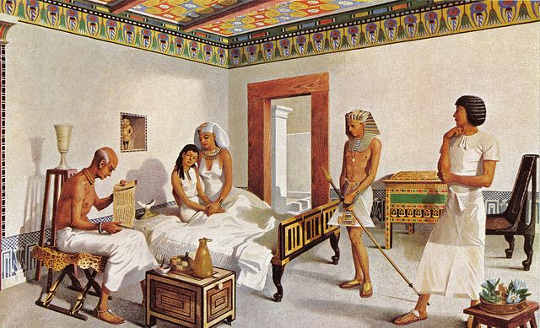
FAMILY
A family consisted of a couple, their children, their parents and grandparents, and sometimes their sisters and brothers
The number of extended Egyptian families did not decrease even after the death of parents and grandparents, as they were treated with respect even after their death

Slide 5
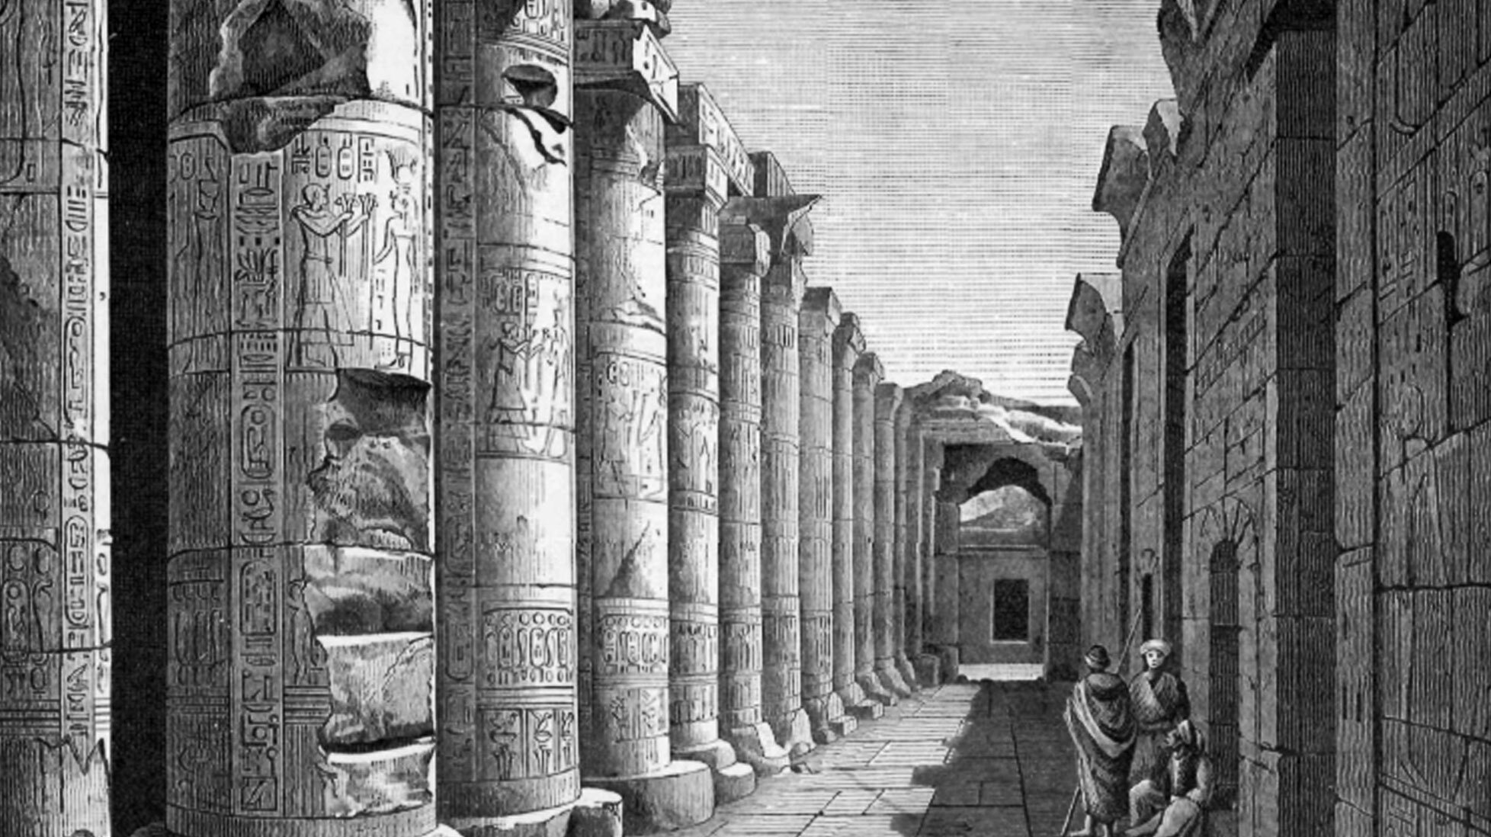
ARCHITECTURE
They are skilled in architecture, sculpture, papyrus and weapon making, clay, leather and woodworking
Today, their creations are the feared treasures of museums around the world
Famous buildings: The Great Pyramid of Giza, the Palaces of the Pharaohs, Tomb Chapels and Theban Temples
There were gods on the pillars
The domestic dwellings of elite and ordinary Egyptians alike were constructed from perishable materials such as mudbricks and wood and have not survived
Peasants lived in simple homes, while the palaces of the elite and the pharaoh were more elaborate structures

Slide 6
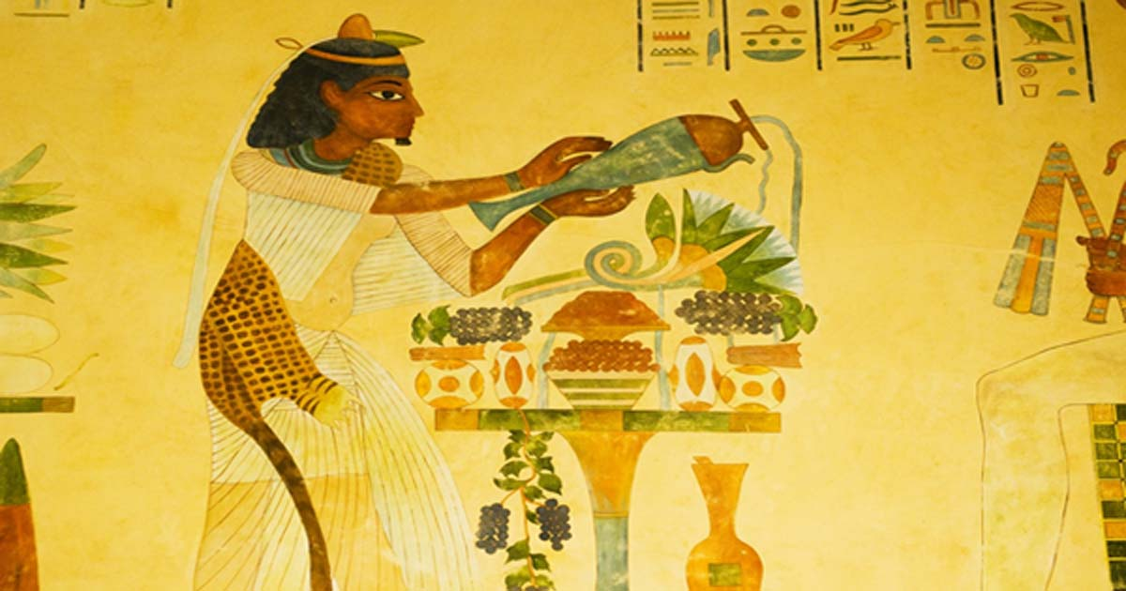
FOOD
The Egyptians grew grains, vegetables and fruits
However, their diets revolved around several staple crops, especially cereals and barley
Other major grains grown included einkorn wheat and emmer wheat, grown to make bread
Egyptians kept sheep, goats, and pigs. Poultry, such as ducks, geese, and pigeons, were captured in nets and bred on farms, where they were force-fed with dough to fatten them
The Nile provided a plentiful source of fish
Bees were also domesticated from at least the Old Kingdom and provided both honey and wax

Slide 7
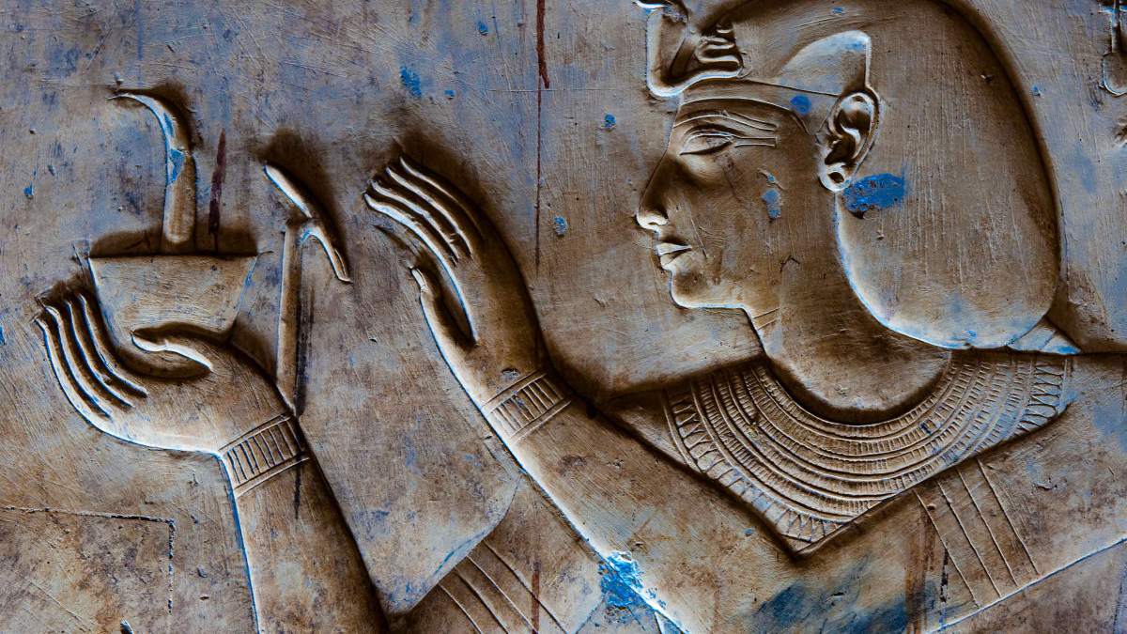
HISTORY
One is too big, it wouldn't even fit in a presentation
More inf on: https://en.wikipedia.org/wiki/Ancient_Egypt

Slide 8
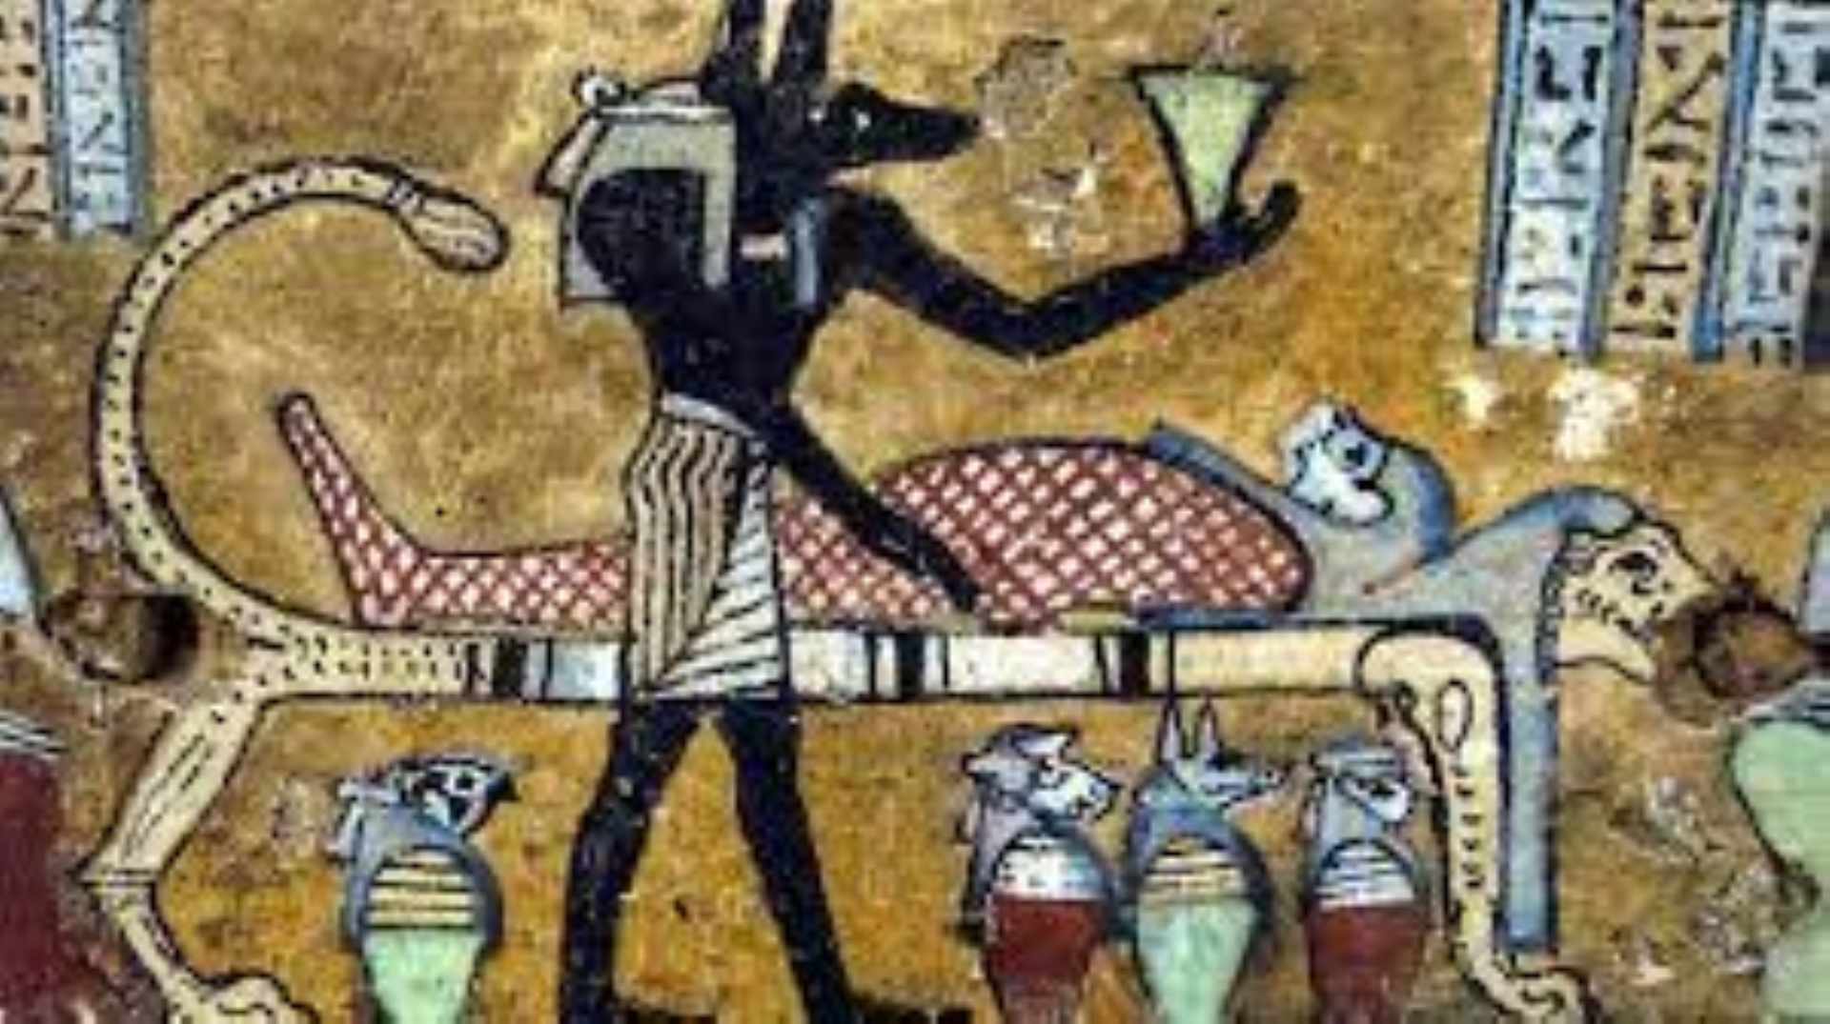
SCIENCE
They were the first to introduce mummification, medicine, agriculture, fermentation, engineering and architecture
They were pioneers in astronomy: their expertise played an important role in determining the annual floods of the Nile and in aligning the pyramids to the pole star
Their measuring skills were very good, as this is how they built the pyramids (many countries envied their accuracy)

Slide 9
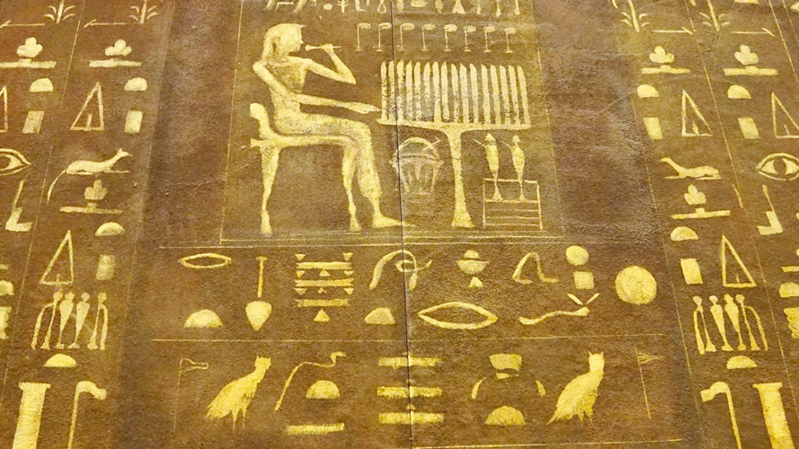
TECHNOLOGY
The Egyptians invented and used many simple machines, such as the ramp and the lever, to aid construction processes
They used rope trusses to stiffen the beam of ships
Egyptian paper and pottery made from papyrus were mass produced

Slide 10
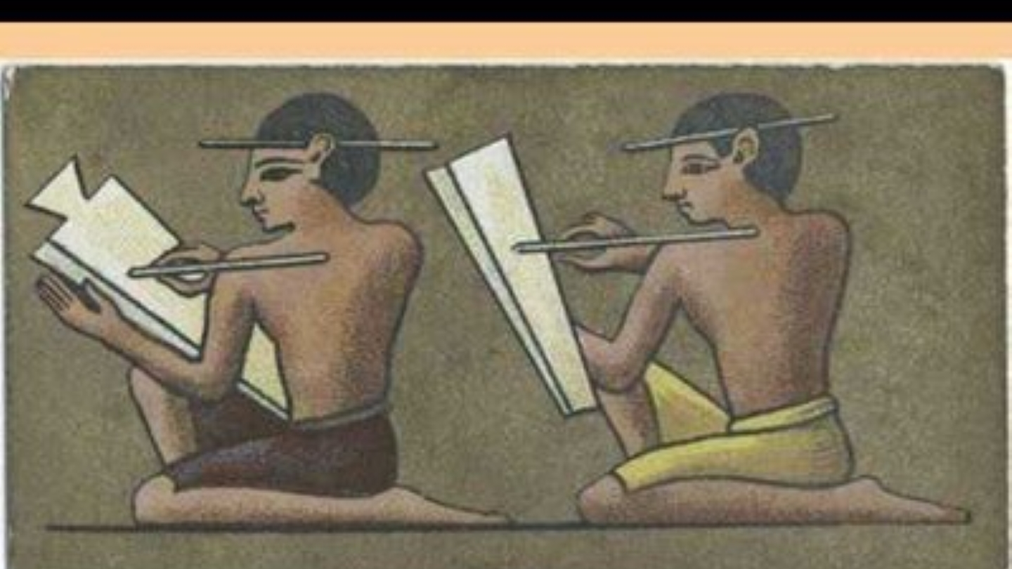
EDUCATION
Education was mostly reserved for boys from wealthier families
There is some evidence that girls sometimes went to school and even became doctors
Boys usually started school at age 7 and were taught reading and writing as well as mathematics

Slide 11
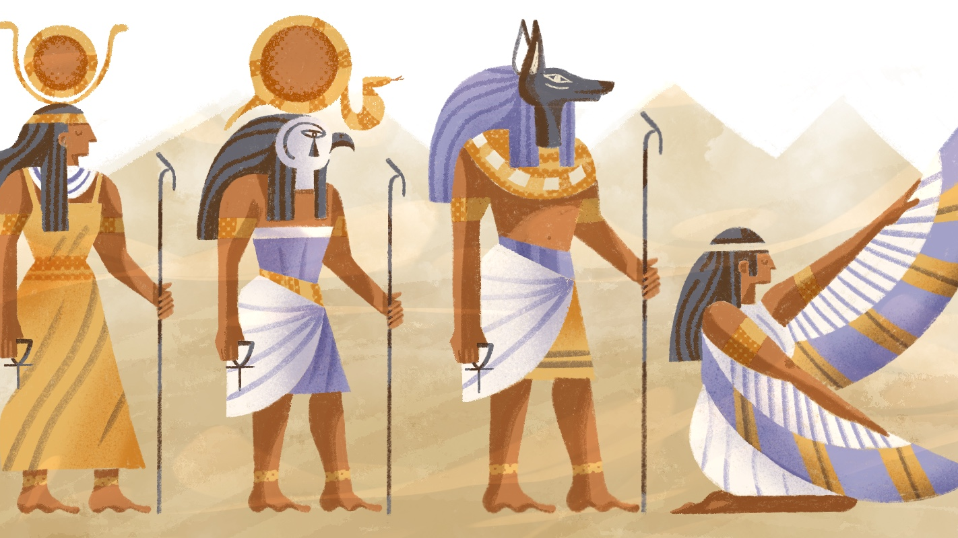
RELIGION
Egyptian religion was polytheistic
The gods who inhabited the bounded and ultimately perishable cosmos varied in nature and capacity
The ancient Egyptians worshipped over 1,400 different gods and goddesses

Slide 12
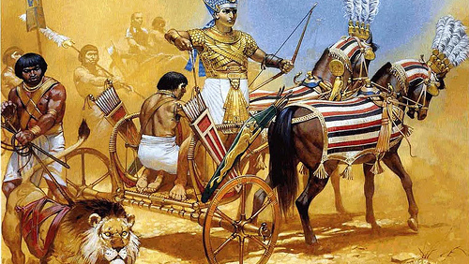
MILITARY
Over 4,000 infantry of an army corps were organized into 20 companies between 200 and 250 men each
The Egyptian army had more than 100,000 soldiers in II. At the time of Ramses
Typical military equipment included bows and arrows, spears, and round-topped shields made by stretching animal skin over a wooden frame
They shot from horse-drawn carriages, and the driver was always in front

Slide 13
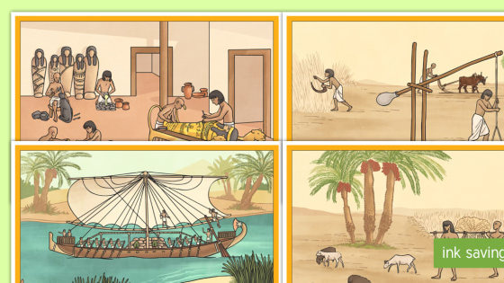
DAILY LIFE
Through the observance of balance & harmony people were encouraged to live at peace with others & contribute to communal happiness
Sports, games, reading, festivals, and time with one's friends and family were as much a part of Egyptian life as toil in farming the land or erecting monuments and temples

Slide 14
Thank you for your attention!
There is a lot of content that could still be done.
Source: https://en.wikipedia.org/wiki/Ancient_Egypt

